Slide 1

Team Name : IdealBits
Team Details: Ch.Jahnavi Ch.Haritha

Slide 2
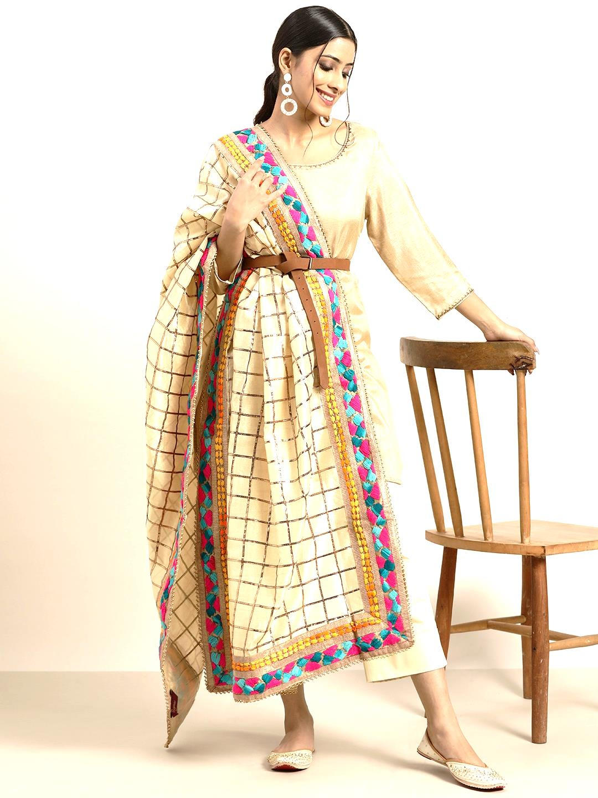
Trend Generation
Objective
.
Our goal is to empower our model to learn from past designs, capturing style nuances, trends, and design elements to produce customized and innovative images. This knowledge forms the basis for generating new creations. Through a streamlined design process, we enable rapid iterations and refinements, empowering designers to explore diverse possibilities with ease.
Step-by-Step Solution
.
Input Images: Feed a dataset of fashion images into your Generative Adversarial Network (GAN) to teach it how to create new designs.
Training with GANs: Train the GAN using unsupervised learning. It includes a generator for creating new designs and a discriminator for distinguishing between generated and real designs.
Generating New Designs: After training, the generator produces diverse fashion designs based on learned patterns and features.

Slide 3
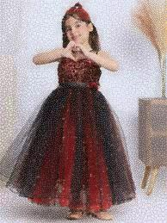
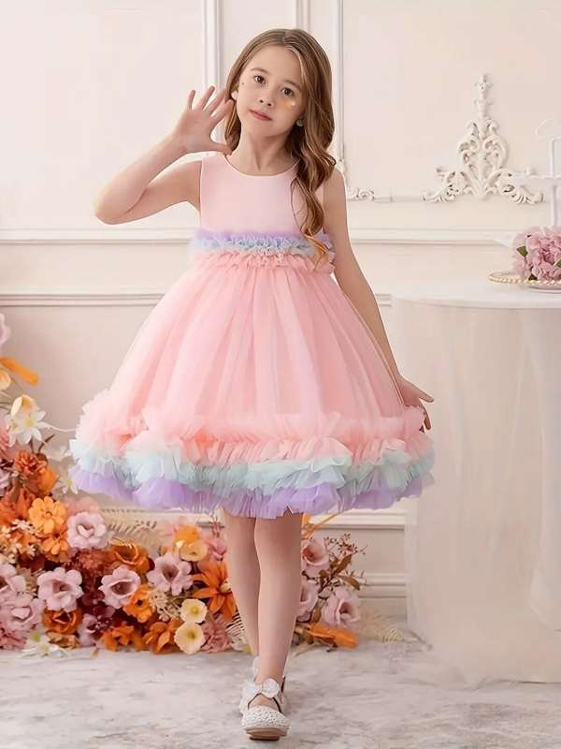
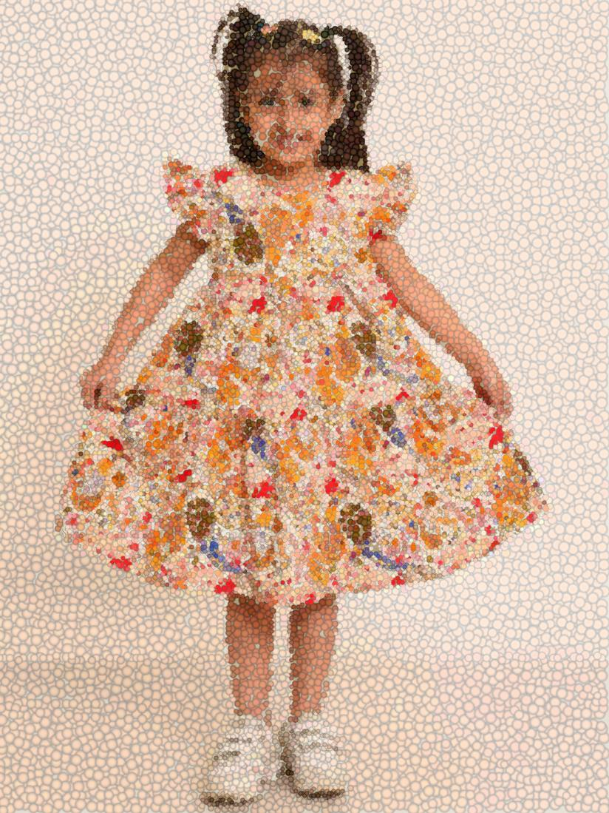
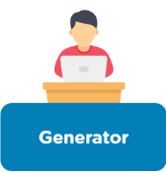
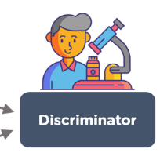
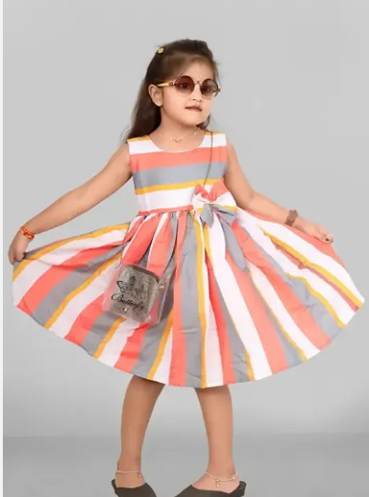

Supervised Learning Integration: Refine GAN outputs using supervised techniques like fine-tuning with additional data. This ensures designs better match specific prompts from users or designers.
Using Prompts: Users provide prompts, such as style preferences or design requirements, guiding the GAN to generate matching designs.
Retrieving Generated Designs: Display and allow users to explore multiple generated designs based on their prompts, enabling them to select designs that best suit their preference
Work Flow
0
0
0
Input Image
1
Generated Images

Slide 4
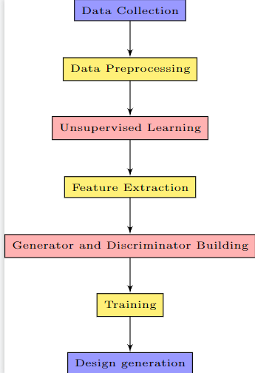
Design Evolution
Understanding the Data
The model starts by learning the patterns and relationships within the vast dataset of fashion designs, without explicit labels or guidance.
Discovering Hidden Connections
The AI explores the dataset, identifying subtle connections between colors, shapes, textures, and design elements.
Building a Foundation for Creativity
This unsupervised learning phase sets the stage for the model to understand the language of fashion and generate its own unique designs.
Technologies and libraries:- Pytorch, Pandas, Machine Learning, GAN(Deep Learning)
Data Flow Diagram

Slide 5
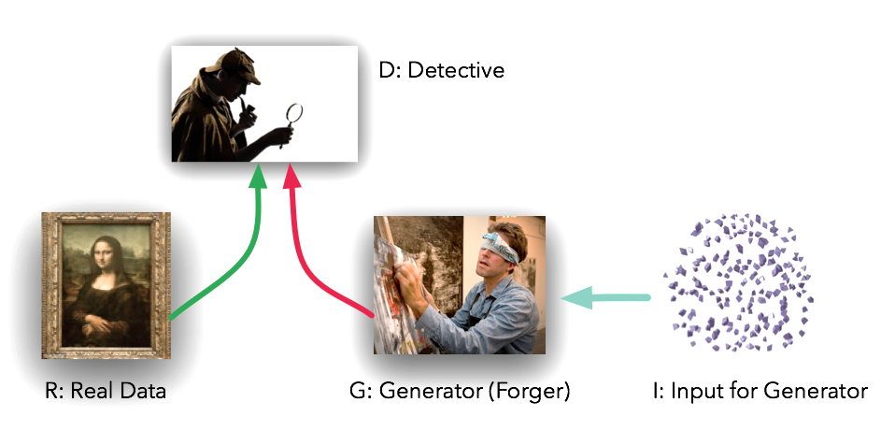
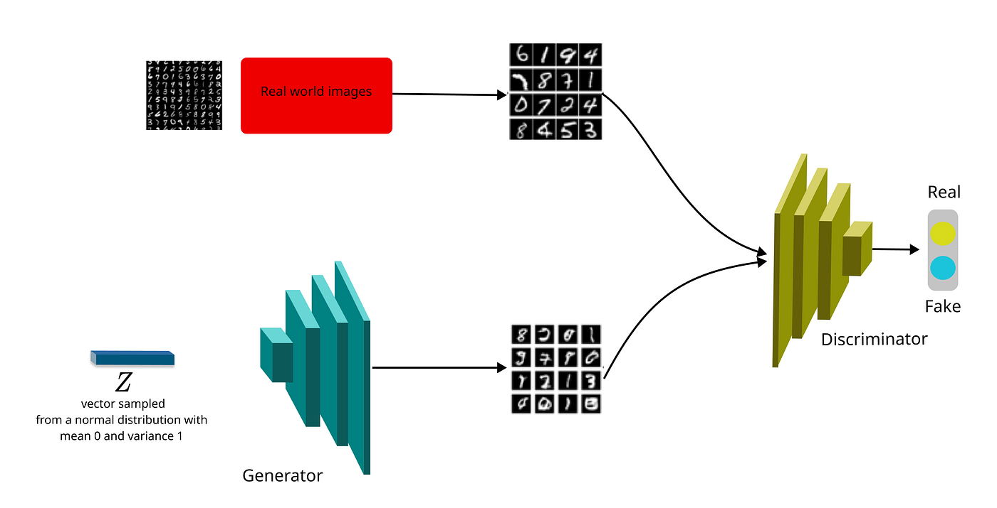
Generator and discriminator
GANs are trained on extensive fashion datasets to learn intricate style patterns. Their generator and discriminator components engage in a dynamic competition, pushing boundaries to craft hyper-realistic and inventive fashion outputs. By combining and recombining learned features, GANs can produce entirely novel fashion designs effortlessly.
Internal Process
Generator : Use their design knowledge to generate initial fashion concepts.
Discriminator : evaluate the generated designs and provide feedback to refine the process.
Refinement : Iterates on the designs, incorporating the evaluation feedback to enhance the final creations.
Technologies Used : GAN (Generative Adversarial Networks)

Slide 6
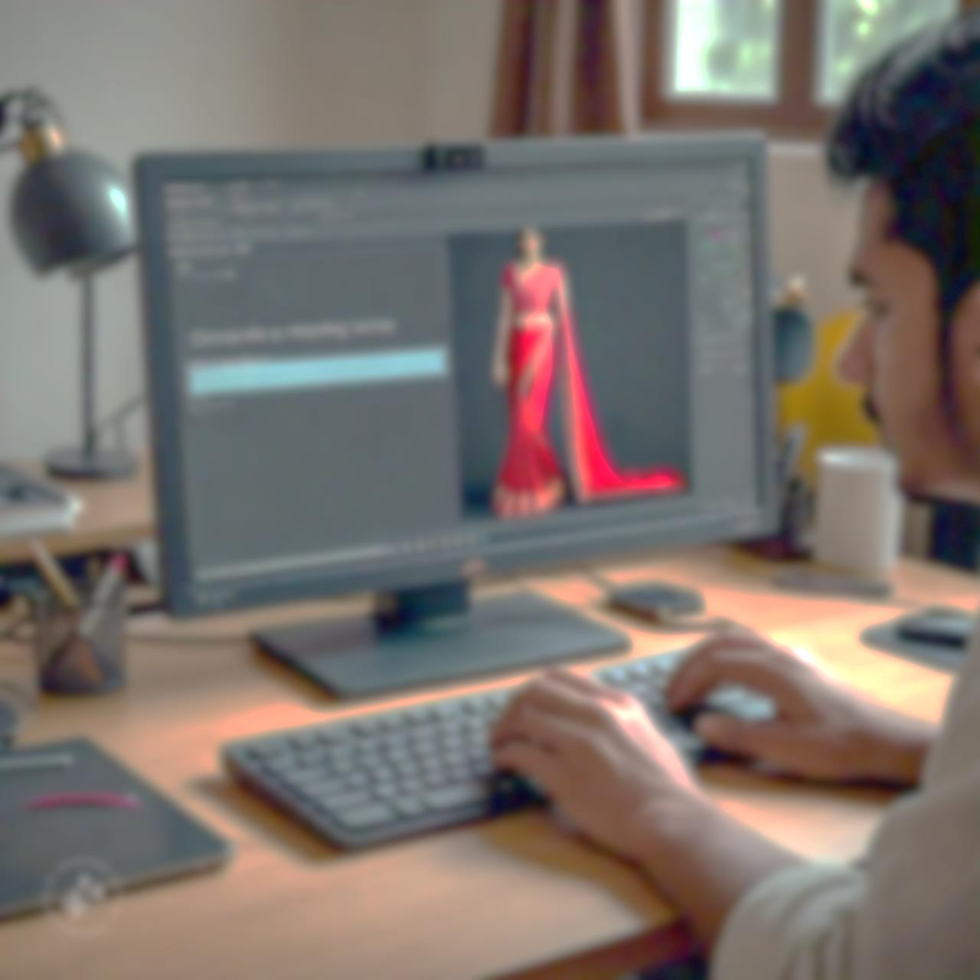
Prompt-Driven Image Design
Objective
The user provides a text-based prompt describing their desired design, to express their vision and model , translates the user's words into visual representations.
Step-by-Step Process
.
Supervised Learning Integration: Fine-tune the GAN using supervised learning techniques. This involves retraining parts of the model using labeled data to align generated designs with specific user prompts.
Prompt Processing
Text Input: Users provide text-based prompts describing their desired fashion designs. These prompts may include style preferences, colors, patterns, and garment types.
NLP Processing: Utilize NLP tools to preprocess and interpret user prompts. Extract
key features and attributes from the text input.
Model Interaction: The model translates processed prompts into visual representations. It generates multiple unique designs based on the input.

